Slide 1
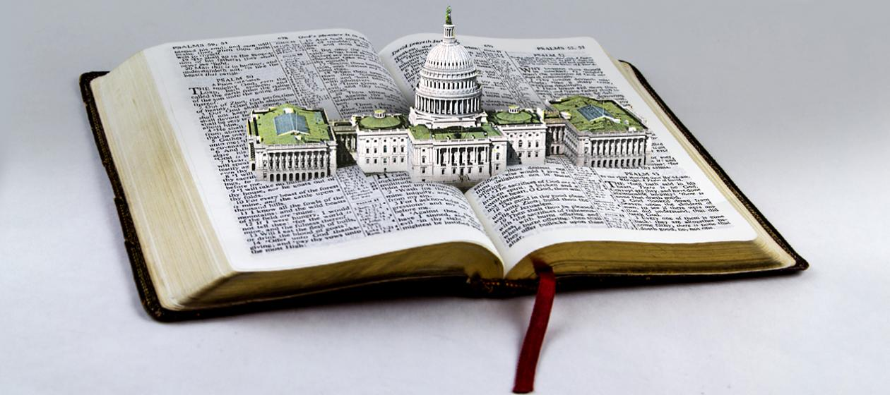
Good Government 好的政權
8/9/2020 Rev. Joseph Chang BOLGPC 爾灣大公園靈糧堂

Slide 2
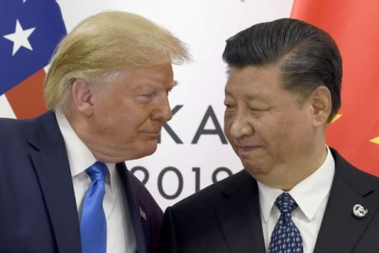
過去/past
現在/now
習近平國家主席
(Chairman Xi Jinping)
習近平總書記
(General Secretary Xi Jinping)
總書記是中國共產黨黨魁的稱呼
It is the title of the leader of the
Communist Party of China.
國家主席是代表整個中國
It represents the whole China.
就是把中國共產黨和中國人民分開了
This is to separate the Chinese Communist Party from
the Chinese people.

Slide 3
習近平的稱呼/Title of Xi Jinping:
中國共產黨中央委員會總書記/General Secretary of Chinese Communist Party Central Committee
中華人民共和國主席/Chairman of People’s Republic of China
中國共產黨中央軍事委員會主席/Chairman of Chinese Communist Party Central Military Committee
中華人民共和國中央軍事委員會主席/Chairman of Central Military Committee of People’s Republic of China

Slide 4
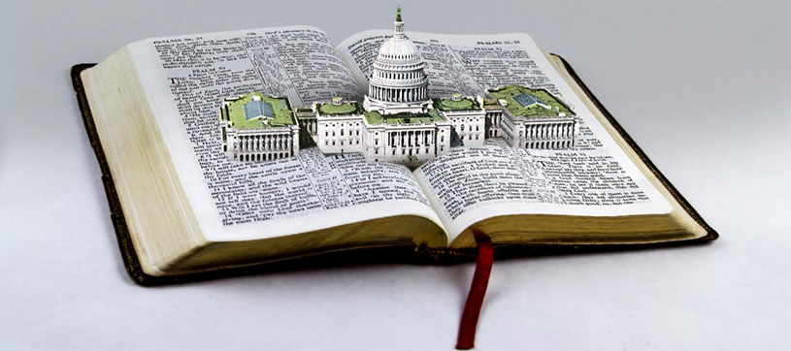
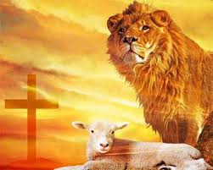
從聖經的角度, 甚麼樣的政權, 才是一個好的政權?

Slide 5
¹在上有權柄的，人人當順服他，因為沒有權柄不是出於神的。凡掌權的都是神所命的。²所以，抗拒掌權的就是抗拒神的命；抗拒的必自取刑罰。³作官的原不是叫行善的懼怕，乃是叫作惡的懼怕。你願意不懼怕掌權的麼？你只要行善，就可得他的稱讚；
¹Let every person be subject to the governing authorities. For there is no authority except from God, and those that exist have been instituted by God. ²Therefore whoever resists the authorities resists what God has appointed, and those who resist will incur judgment. ³For rulers are not a terror to good conduct, but to bad. Would you have no fear of the one who is in authority? Then do what is good, and you will receive his approval,

Slide 6
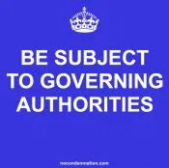
⁴因為他是神的用人，是與你有益的。你若作惡，卻當懼怕；因為他不是空空的佩劍，他是神的用人，是伸冤的，刑罰那作惡的。⁵所以你們必須順服，不但是因為刑罰，也是因為良心。
⁴for he is God's servant for your good.
But if you do wrong, be afraid, for he
does not bear the sword in vain. For
he is the servant of God, an avenger
who carries out God's wrath on the
wrongdoer. ⁵Therefore one must be in
subjection, not only to avoid God's wrath
but also for the sake of conscience.

Slide 7
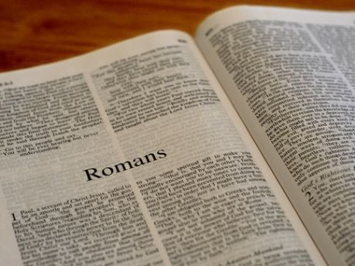
⁶你們納糧，也為這個緣故；因他們是神的差役，常常特管這事。⁷凡人所當得的，就給他。當得糧的，給他納糧；當得稅的，給他上稅；當懼怕的，懼怕他；當恭敬的，恭敬他。【羅 13:1~7】⁶For the same reason you also pay taxes, for the authorities are ministers of God, attending to this very thing. ⁷Pay to all what is owed to them: taxes to whom taxes are owed, revenue to whom revenue is owed, respect to whom respect is owed, honor to whom honor is owed. 【Rom 13:1~7】

Slide 8
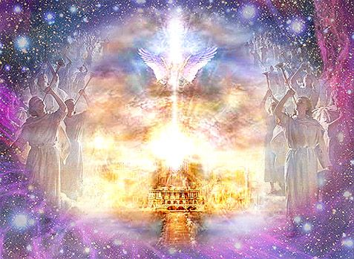
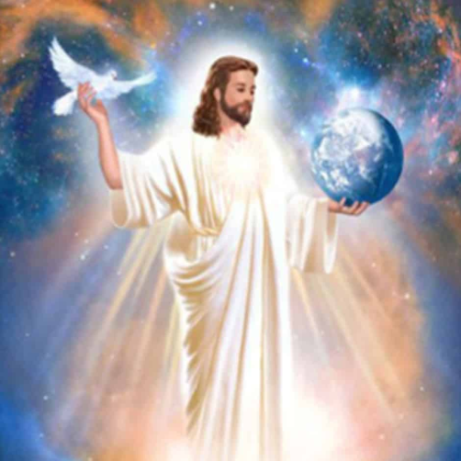
I. The source of authority is from God.
權柄的來源是上帝 (vv. 1-2).

Slide 9
A. 中國的帝王制度, 皇帝自稱為天子, “天的兒子”.
In China's imperial system, the emperor called himself
the Son of God.
B. 現代的民主制度認為 “天賜人權” 然後經過人民的同
意, 才有政權的產生.
The modern democratic system believes that "human
rights are bestowed by God" , and then government power only can be produced by the consent of people.
C. 中國共產黨/the Communist Party of China:

Slide 10
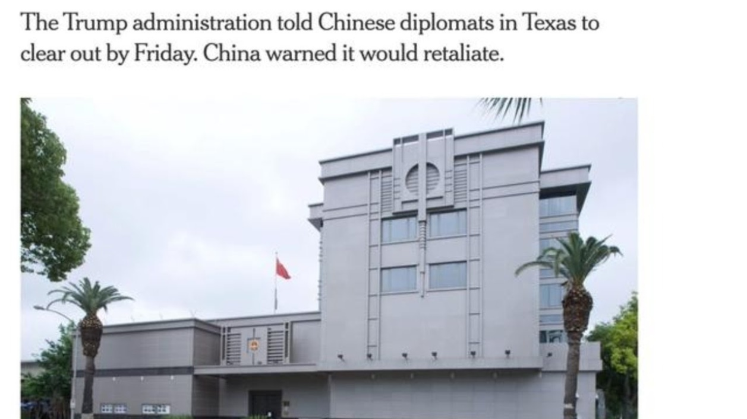
7/22/2020美國令中國的休士頓領館關閉.
The Trump administration closed the Chinese Consulate
in Houston on 7/22/2020.

Slide 11
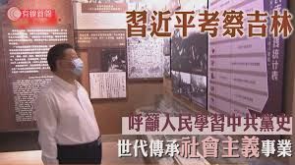
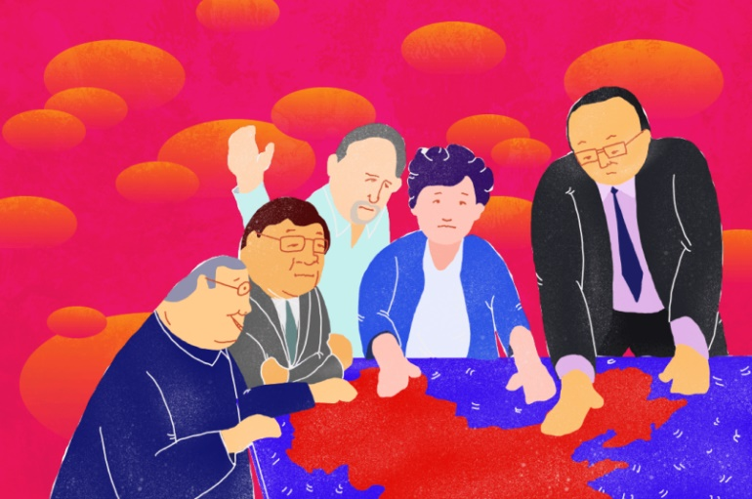
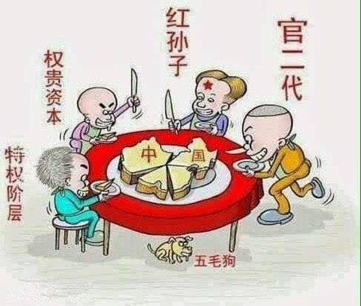

Slide 12
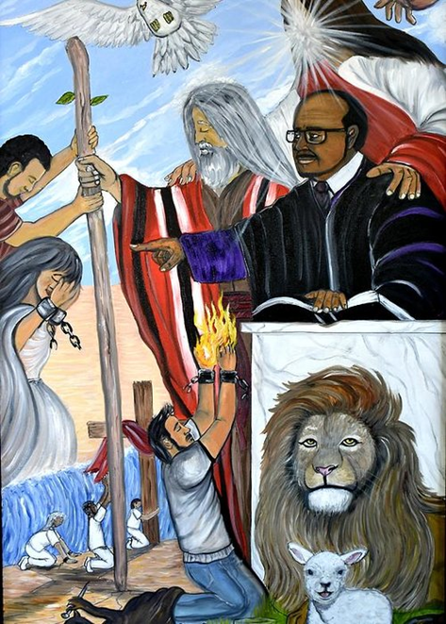
II. Divine Authority→Human Right→State Right
神權→人權→君權

Slide 13
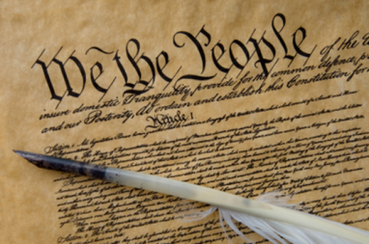
In Congress, July 4, 1776
The unanimous Declaration of the thirteen united States of America, When in the Course of human events, it becomes necessary for one people to dissolve the political bands which have connected them with another, and to assume among the powers of the earth, the separate and equal station to which the Laws of Nature and of Nature's God entitle them, a decent respect to the opinions of mankind requires that they should declare the causes which impel them to the separation.
在人類的歷史上, 有時候一群人必須從另外一群人的政治關聯上割捨開來, 彼此成為分開, 獨立, 對等的政治實體. 這政治實體是
自然律和自然的神所給他們權柄可以設立的. 因為尊敬別人的意見, 今天我們必須清楚的向人類宣告是什麼原因使我們要分離.

Slide 14
We hold these truths to be self-evident, that all men are created equal, that they are endowed by their Creator with certain unalienable Rights, that among these are Life, Liberty and the pursuit of Happiness.--That to secure these rights, Governments are instituted among Men, deriving their just powers from the consent of the governed, --That whenever any Form of Government becomes destructive of these ends, it is the Right of the People to alter or to abolish it, and to institute new Government, laying its foundation on such principles and organizing its powers in such form, as to them shall seem most likely to effect their Safety and Happiness.
我們相信下列的真理是不問自明的, 每個人心裡可以曉得, 無可推諉的: 所有的人是受造而平等的, 每個人都擁有創造主付與他們不可分離, 不能被剝奪的權力, 譬如:生命, 自由, 和追求幸福的權力. 為了要保有這些權力, 政府就由人民當中產生, 政府的權柄是由接受統治的人民同意後產生的. 如果任何時候政府變為要破壞這些權力, 那麼人民有權改變或甚至除掉這樣的政府, 另立新的政府, 設下新的政治原則, 政治制度, 使得人民可以享受安全和幸福.

Slide 15
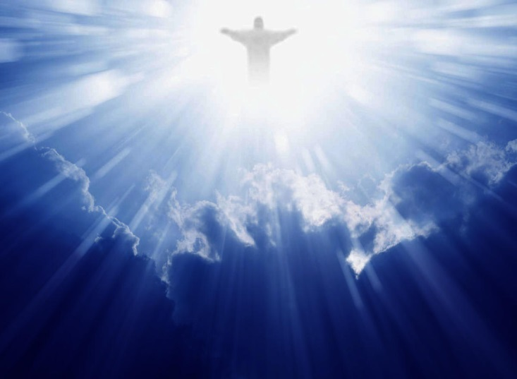
A. Human Rights come from the Lord/人權從神而來

Slide 16
¹⁴沒有律法的外邦人若順著本性行律法上的事，他們雖然沒有律法，自己就是自己的律法。¹⁵這是顯出律法的功用刻在他們心裡，他們是非之心同作見證，並且他們的思念互相較量，或以為是，或以為非。）
【羅 2:14~15】 ¹⁴For when Gentiles, who do not have the law, by nature do what the law requires, they are a law to themselves, even though they do not have the law. ¹⁵They show that the work of the law is written on their hearts, while their conscience also bears witness, and their conflicting thoughts accuse or even excuse them 【Rom 2:14~15】

Slide 17
B. Government authority comes from the people
君權從人而來
創造主
creator
人民
people
政府
government

Slide 18
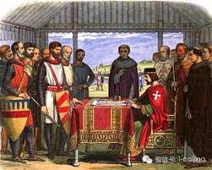
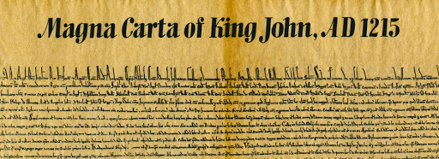
英國在1215年英王King John所簽署的Magna Carta (大憲章)
The Magna Carta (Magna Carta) signed by King John of England in 1215

Slide 19
C. Biblical Support聖經的支持

Slide 20
¹⁰弟兄們隨即在夜間打發保羅和西拉往庇哩亞去。二人到了，就進入猶太人的會堂。¹¹這地方的人賢於帖撒羅尼迦的人，甘心領受這道，天天考查聖經，要曉得這道是與不是。
【徒 17:10~11】 ¹⁰The brothers immediately sent Paul and Silas away by night to Berea, and when they arrived they went into the Jewish synagogue. ¹¹Now these Jews were more noble than those in Thessalonica; they received the word with all eagerness, examining the Scriptures daily to see if these things were so. 【Acts 17:10~11】

Slide 21
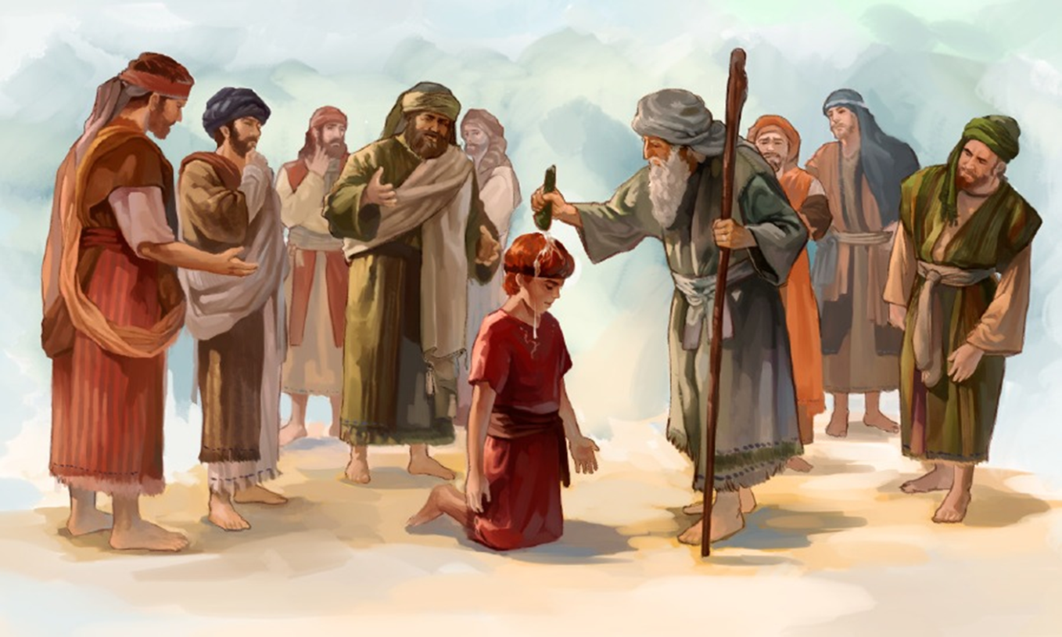

Slide 22
¹以色列眾支派來到希伯崙見大衛，說：我們原是你的骨肉。²從前掃羅作我們王的時候，率領以色列人出入的是你；耶和華也曾應許你說：你必牧養我的民以色列，作以色列的君。³於是以色列的長老都來到希伯崙見大衛王，大衛在希伯崙耶和華面前與他們立約，他們就膏大衛作以色列的王。
¹Then all the tribes of Israel came to David at Hebron and said, "Behold, we are your bone and flesh. ²In times past, when Saul was king over us, it was you who led out and brought in Israel. And the Lord said to you, 'You shall be shepherd of my people Israel, and you shall be prince over Israel.' " ³So all the elders of Israel came to the king at Hebron, and King David made a covenant with them at Hebron before the Lord, and they anointed David king over Israel.

Slide 23
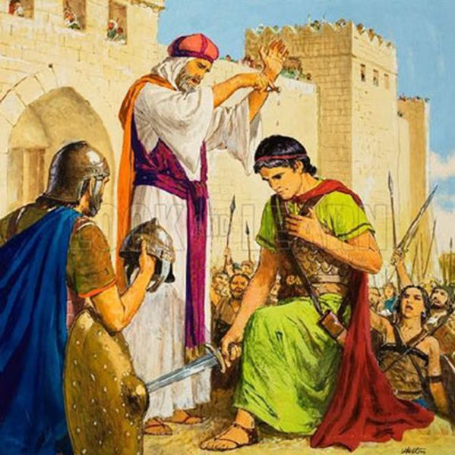
⁴大衛登基的時候年三十歲，在位四十年；
⁵在希伯崙作猶大王七年零六個月，在耶路
撒冷作以色列和猶大王三十三年。
【撒下 5:1~5】 ⁴David was thirty years old when he began to
reign, and he reigned forty years. ⁵At Hebron
he reigned over Judah seven years and six
months, and at Jerusalem he reigned over all
Israel and Judah thirty-three years.
【2Sam 5:1~5】

Slide 24
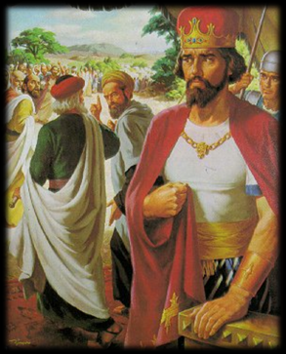
¹⁶以色列眾民見王不依從他們，就對王說：我們與大衛有甚麼分兒呢？與耶西的兒子並沒有關涉。以色列人哪，各回各家去罷！大衛家啊，自己顧自己罷！於是，以色列人都回自己家裡去了，
【王上 12:16】 ¹⁶And when all Israel saw that the king
did not listen to them, the people answered
the king, "What portion do we have in David
? We have no inheritance in the son of Jesse.
To your tents, O Israel! Look now to your own
house, David." So Israel went to their tents.
【1King 12:16】

Slide 25
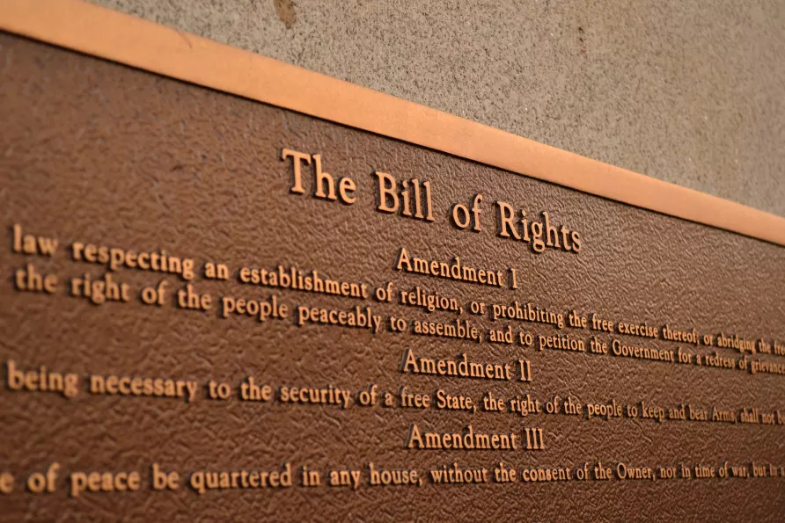
III. A Good Government Guards People’s Right
好的政府要保護人民的權力.

Slide 26
³作官的原不是叫行善的懼怕，乃是叫作惡的懼怕。你願意不懼怕掌權的麼？你只要行善，就可得他的稱讚；⁴因為他是神的用人，是與你有益的。你若作惡，卻當懼怕；因為他不是空空的佩劍，他是神的用人，是伸冤的，刑罰那作惡的。
【羅 13:3~4】 ³For rulers are not a terror to good conduct, but to bad. Would you have no fear of the one who is in authority? Then do what is good, and you will receive his approval, ⁴for he is God's servant for your good. But if you do wrong, be afraid, for he does not bear the sword in vain. For he is the servant of God, an avenger who carries out God's wrath on the wrongdoer. 【Rom 13:3~4】

Slide 27
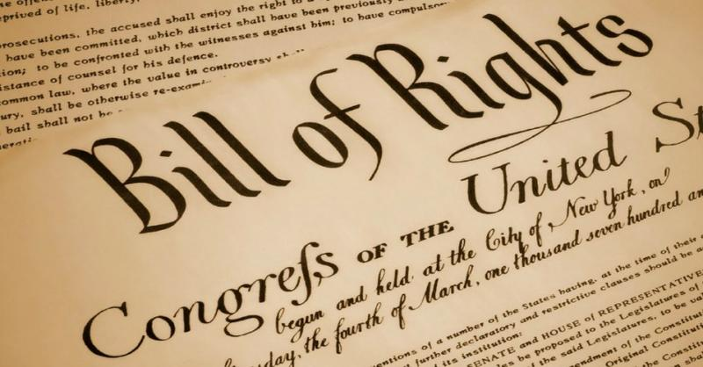
人權修正案Bill of Rights/Constitution Amendment.
The Bill of Rights is the first 10 Amendments to the Constitution. ... It guarantees civil rights and liberties to the individual—like freedom of speech, press, and religion. It sets rules for due process of law and reserves all powers not delegated to the Federal Government to the people or the States.

Slide 28
The 1st Amendment (Freedom of speech, press, religion, assembly, and petition/言論自由, 出版自由, 信仰自由, 集會自由, 請願自由) states: “Congress shall make no law respecting an establishment of religion, or prohibiting the free exercise thereof; or abridging the freedom of speech, or of the press; or the right of the people peaceably to assemble, and to petition the Government for a redress of grievances.”
The 2nd Amendment (Right to bear arms/擁有武器的權力) states: “A well regulated Militia, being necessary to the security of a free State, the right of the people to keep and bear Arms, shall not be infringed.”

Slide 29
The 3rd Amendment (Citizens do not have to house soldiers/可以拒絕軍人來家裡住) addressed colonists' grievances with British soldiers, and has since played only a small role in legal cases. ... It reads, in full: “No Soldier shall, in time of peace be quartered in any house, without the consent of the Owner, nor in time of war, but in a manner to be prescribed by law.”
The 4th Amendment (No unreasonable search or arrest/不能隨意搜查或逮捕) protects people from unreasonable searches and seizures by the government.

Slide 30
The 5th Amendment (No double jeopardy or no witness against yourself/不能兩次審判同樣的罪, 不能被自我定罪) states "No person shall be held to answer for a capital, or otherwise infamous crime, unless on a presentment or indictment of a grand jury, except in cases arising in the land or naval forces, or in the militia, when in actual service in time of war or public danger; nor ...
The 6th Amendment (Rights of accused in criminal cases to fair trial/受公正審判的權力) guarantees the rights of criminal defendants, including the right to a public trial without unnecessary delay, the right to a lawyer, the right to an impartial jury, and the right to know who your accusers are and the nature of the charges and evidence against you.

Slide 31
The 7th Amendment (Trial by Jury/有陪審團的受審權力) requires civil jury trials only in federal courts.
The 8th Amendment (No excessive bail, fines, or cruel and unusual punishment/不能天價保釋費用, 不能殘酷的用刑) states “Excessive bail shall not be required, nor excessive fines imposed, nor cruel and unusual punishments inflicted.”

Slide 32
The 9th Amendment (You have other rights not stated here/你的權力過多, 這裡不及備載) “The enumeration in the Constitution, of certain rights, shall not be construed to deny or disparage others retained by the people”.
The 10th Amendment (Limited federal government, by default, rights are in the hands of people and state小政府, 大多數權力在人民和州政府手中) provides the powers “reserved” to the states. ... The powers not delegated to the United States by the Constitution, nor prohibited by it to the States, are reserved to the States respectively, or to the people.

Slide 33
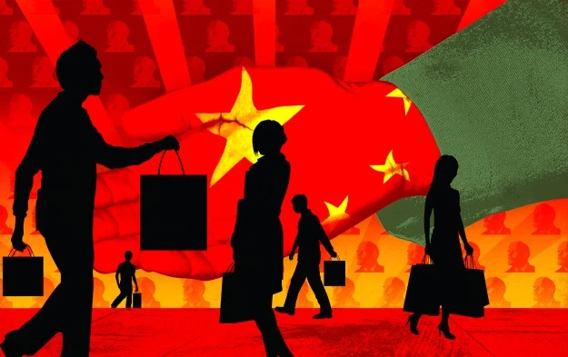
將來要的中國政府, 不是一個強權的政府, 而是一個尊重人民權力的政府.
The ideal future Chinese government will not be a powerful government, but a government that respects the rights of people.

Slide 34
IV. How?/該如何做呢?

Slide 35
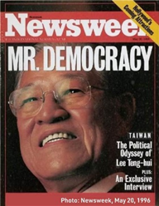
A. Leader responds to the initiative of the people
領導人回應百姓的需求.

Slide 36
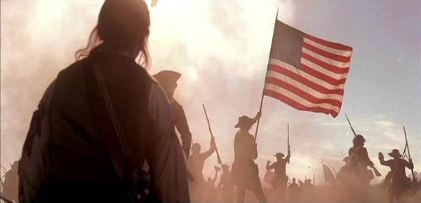
B. Interposition 權柄介入說
美國獨立戰爭的革命
the American Revolutionary War
Interposition
這些次級的領導人就是美國13州議會的議員們.
These secondary leaders are members of the 13 U.S. state legislatures.

Slide 37
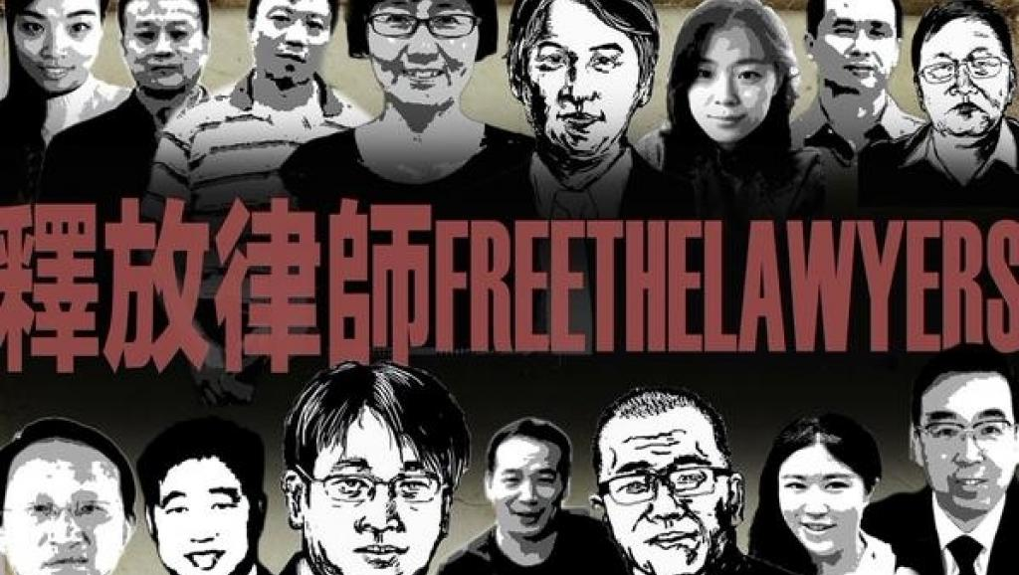
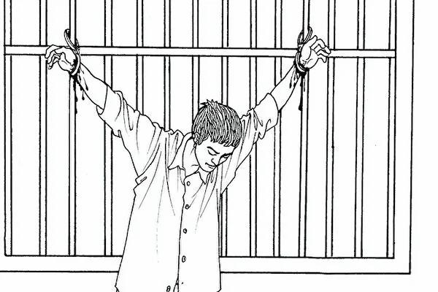
維權律師 (Human Rights Lawyers/Civil Rights Lawyers)

Slide 38
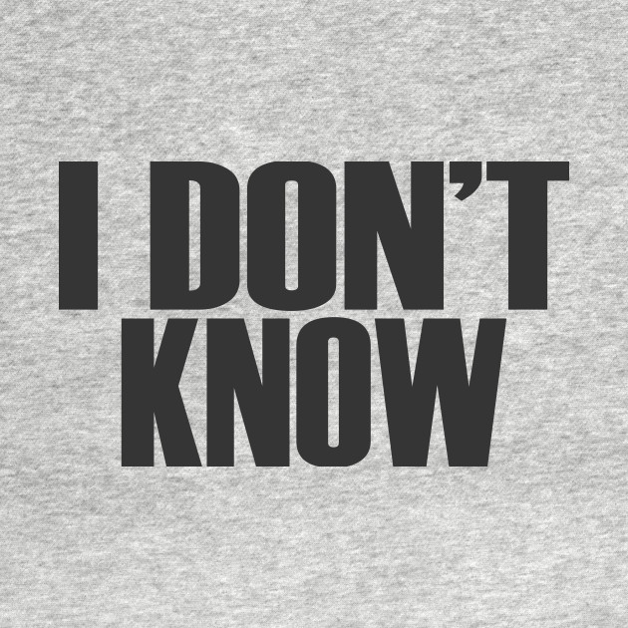
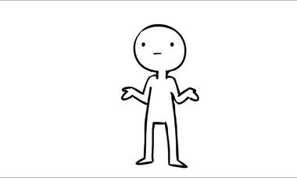
C. Other Means其他的方法

Slide 39
Conclusion結論
讓我們為中國禱告, 讓中國成為民主, 自由, 法治的社會. (Free, Law-abiding, and Democratic Society). 讓六四被屠殺的那些為了中國的民主法治而出來遊行的人, 他們的死不至於白白的死.
Let us pray to God that China will become a Free, Law-abiding, and Democratic Society. Don't let those who were massacred for China's democracy die in vain.

